Slide 1
Group Data Analysis 3 College Basketball
Luke Nichols & Jager Springer
Group Data Analysis 2

Slide 2
Business Problem
What statistical metrics drive a successful college basketball season?
School’s conference earn $2 million for each NCAA tournament game the team appears in.

Slide 3
Who Does This Benefit?
Coaches: Improve team strategy and player development
Athletic Directors: Data-driven coaches hires and budgeting decisions
Scouts and Analyst: Identify top-performing teams and future trends.

Slide 4
Executive Summary
Offensive and defensive efficiency, turnover rates, and shooting percentages were key predictors of postseason appearance.
Our logistic regression model had an accuracy of 90.1% on the test set.
We predict Utah State has a low probability of making the 2025 NCAA Tournament based on current projections.

Slide 5
Dataset Overview
Source: Kaggle – NCAA teams from 2013 to 2023
Sample: Power 7 conferences only (ACC, B10, B12, P12, WCC, BE, SEC, MWC)
Target Variable: POSTSEASON (1 = made NCAA tournament)
Key Variables: Offensive/Defensive Efficiency (ADJOE/ADJDE), Turnover Rates (TORD), Shooting % (2P_O, 3P_O, 3P_D), Rebounding (ORB), Free Throw Rate (FTR), and Tempo (categorized as Slow, Moderate, Fast)

Slide 6
Dataset Overview
Original dataset had the following variables:
Continuous predictor variables:
ADJOE (Adjusted Offensive Efficiency)
ADJDE (Adjusted Defensive Efficiency)
BARTHAG
TOR (Offensive Turnover Rate)
TORD (Defensive Turnover Rate)
EFG_O (Effective Field Goal Percentage – Offense)
EFG_D (Effective Field Goal Percentage – Defense)
FTR (Free Throw Rate – Offense)
FTRD (Free Throw Rate – Defense)
ORB (Offensive Rebound Percentage)
DRB (Defensive Rebound Percentage)
2P_O (Two-Point Shot Percentage – Offense)
2P_D (Two-Point Shot Percentage – Defense)
3P_O (Three-Point Shot Percentage – Offense)
3P_D (Three-Point Shot Percentage – Defense)
ADJ_T (Adjusted Tempo)
Categorical predictor variables:
Conference
Tempo (we chose to discretize tempo into slow, moderate, and fast.)

Slide 7
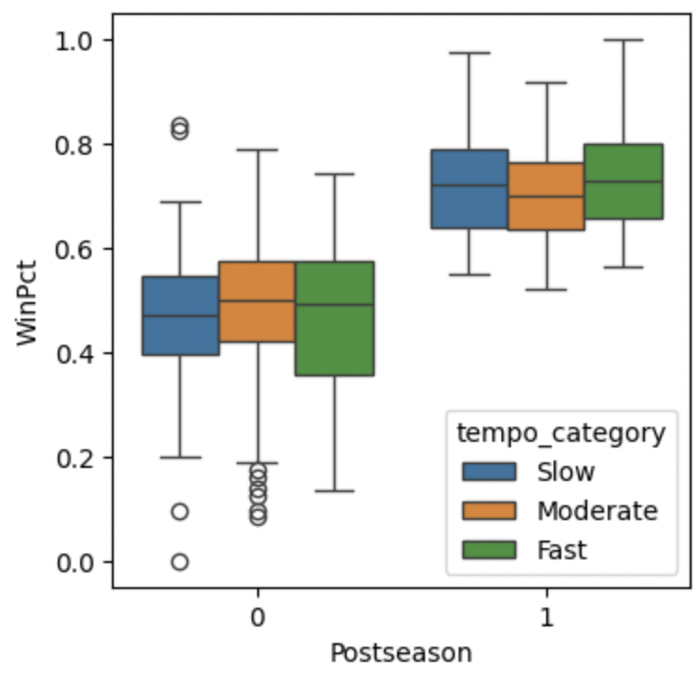
Exploratory Data Analysis - Tempo
Teams that make the postseason have a much higher win percentage than those who do not (duh.)
Tempo can have a much different trend on a team’s win percentage for postseason teams rather than non-postseason teams.
  Postseason: moderate tempo has the lowest, then slow tempo, and then fast tempo.
  Non-postseason: moderate tempo has the highest, then fast tempo, then slow tempo.

Slide 8
Variable Selection
We used both:
Backward stepwise selection
Elastic Net regularization
Final model included:
ADJOE, ADJDE, TORD, ORB
2P_O, 3P_O, 3P_D, FTR
Tempo category (Fast, Slow)
Variables later removed due to multicollinearity issues: BARTHAG, WAB

Slide 9
Fitted Regression Model
This model identifies efficient offense, lower opponent efficiency, drawing fouls, and playing a fast tempo as key traits of postseason-caliber teams.

Slide 10
Model Assumption Checks
Linearity (X vs log-odds): All but TORD showed strong linearity. Kept TORD after testing transformations/interactions
Independence: Each team-season is unique
Influential Points: One bid-stealer (2015 Wyoming) flagged, but kept in
Multicollinearity: All VIFs < 4 after removing problematic variables

Slide 11
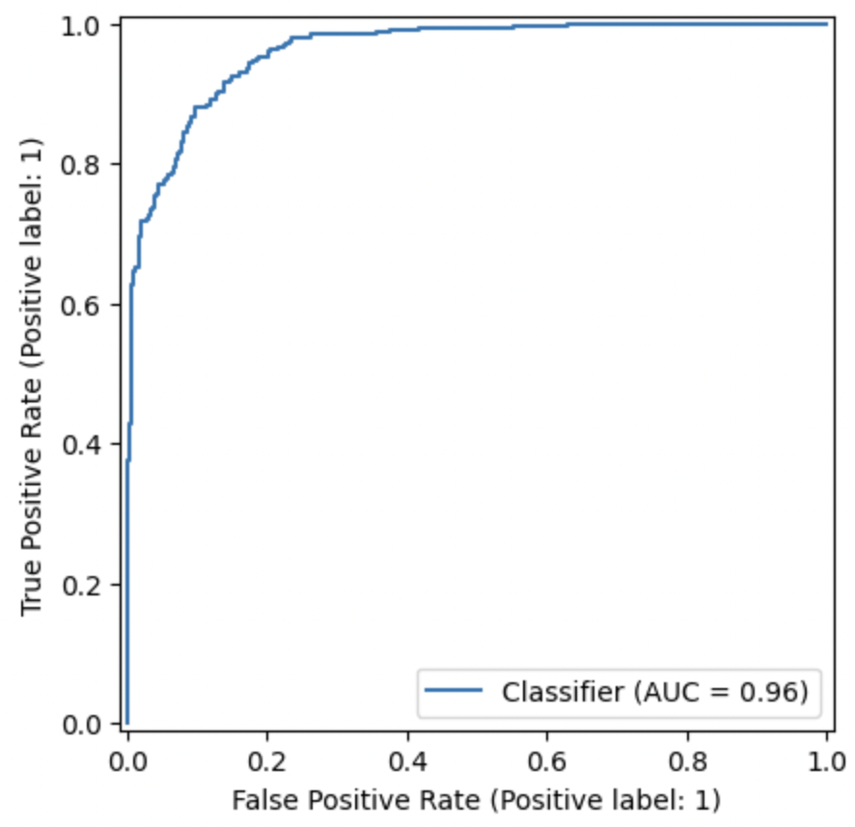
Model Evaluation
LLR p-value: 1.078 e-136
AUC: 0.9684

Slide 12
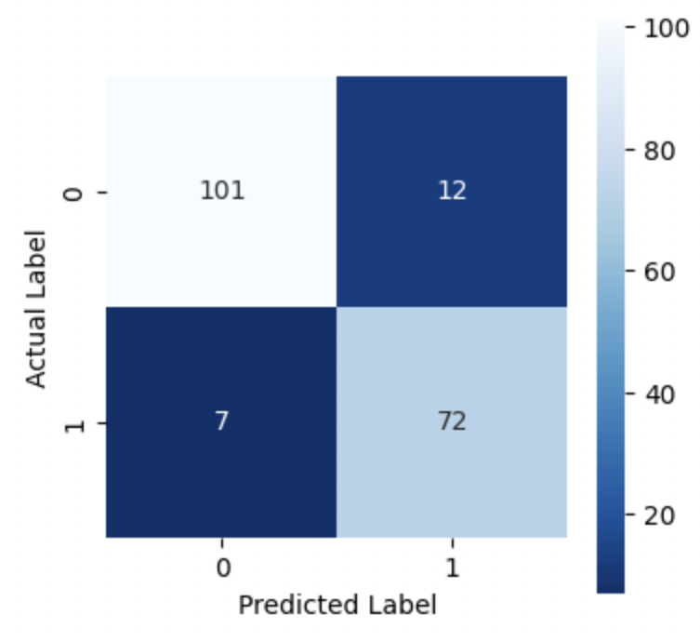
Confusion Matrix
Accuracy: 90.1%
Sensitivity (true positive rate): 91.1%
Specificity (true negative rate): 89.4%
19 missed team predictions were all on the bubble, meaning they likely could’ve gone either way.

Slide 13
Predicting Utah State (2024-2025)
Using projected stats:
ADJOE: 119.8
ADJDE: 105.8
TORD: 20.1
ORB: 34.7
2P_O: 57.5
3P_O: 34.9
3P_D: 34.0
FTR: 38.1
Tempo: Moderate (baseline)
Predicted Probability: 30.47% chance to make the postseason.

Slide 14
Business Recommendations
Coaches & Recruiters: Prioritize offensive and defensive efficiency, FTR, and low turnover rates
Analysts: Consider conference and tempo when comparing bubble teams
Athletic Departments: Use data-driven strategy for postseason planning

Slide 15
Limitations & Future Work
While our model performed very well overall, most of the teams missed in predictions were on the tournament bubble, which is to be expected.
However, this is likely the subset that would be most valuable to study in the future.
Future variations of this model could possible shrink down to simply teams on the bubble, allowing you to easier find which factors can get teams on the right side of the bubble.

Slide 16
Questions?
https://www.kaggle.com/code/yyue11/college-basketball-data-analysis

